Slide 1
Web Development
Lecture 1

Slide 2











About myself
IIT Kanpur
Vibinex

Slide 3
About you

Slide 4
Introduction to the web
Protocol
TCP/IP (Transmission Control Protocol / Internet Protocol)
Network
Internet

Slide 5
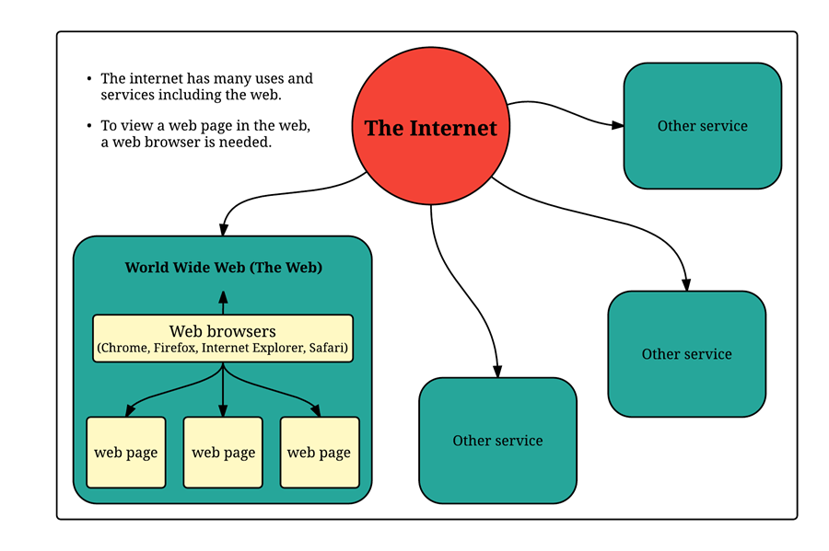

Slide 6
Introduction to the web
Internet services
Mobile apps – REST API, GRPC
Email - SMTP
File sharing - FTP
World wide web – TCP/IP, UDP
Internet telephony -
Online multiplayer games – UDP
Voice assistants like Alexa or Google Home

Slide 7
Introduction to the web
World Wide Web
Browsers
Resources
Images
Audio
Video
Documents
TXT
JSON
XML
HTML

Slide 8
Web pages and websites
HTML
HyperText Markup Language
HyperLinks
Browsers understand how to render it
Structure

